Slide 1
PRESENTATION ON
HOSPITAL MANAEMENT SYSTEM USING C PROGRAMM

Slide 2
SUBMITTED BY :
Names and ids:
Tahia Tamim Pushpa - (2023100000355)
Khadija aktar – (2023100000501)
Farzana Easmin Anonna – (2023100000604)
Md.Mahfujur Rahman Lijohn – (2023100000153)
SUBMITTED TO :
Md. Habibullah Belali
Assistant Professor
Department of CSE
Southeast University

Slide 3

TABLE OF CONTENTS
01
04
INTRODUCTION
Billing Records
02
05
Patient Information
Waiting Room
03
Medical Records

Slide 4
INTRODUCTION
01

Slide 5
02
Patient Information
Traverse using Linked List
Patientinfo Function
Node
Node
Node
Node
Node

Slide 6
02
Patient Information
addnewpatient Function
Add
Node
Node
Node
It uses another function called (allpatient) to create a new node of node structure data type. In here after creating the new node it assigns the values to the members that was taken from the user.
New Node

Slide 7

02
Patient Information
Search
Searchpatient Function
Searches through the entire list comparing the user input id with patient id.
Node
Node
Node
Node

Slide 8
02
Patient Information
02
deletepatient Function
remove
The program searches through the list to find the desired id that the user want to delete. After finding the id the program links the previous node of the id to the next node of the id and then frees the id node.
Node
Node
Node
removed Node

Slide 9

03
Medical Records
CreateReport Function
Dynamically allocates memory for a new structure and initializes it with the provided values. It returns a pointer to the newly created and initialized new structure
Node
Node

Slide 10
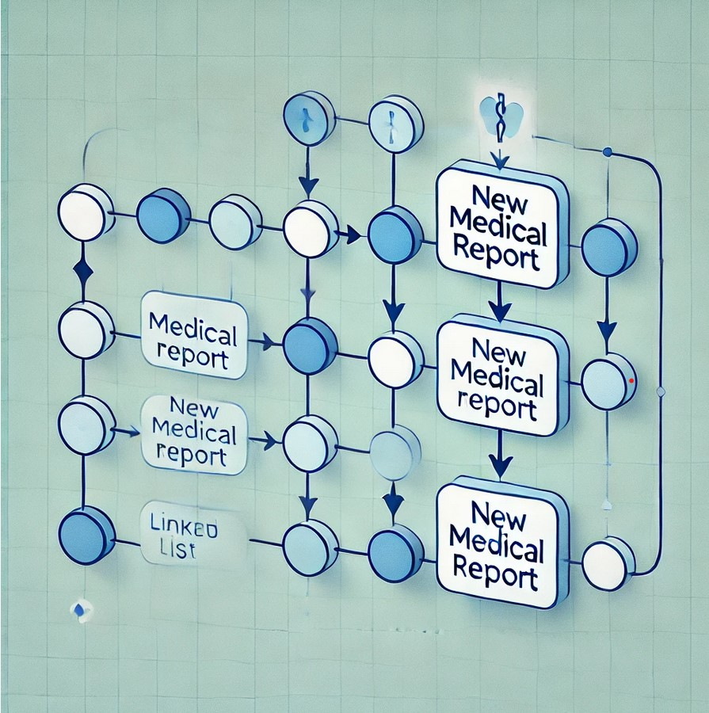
03
Medical Records
addReport Function
At first, inserts a new Medical Report at the beginning of a linked list.This function effectively adds new Report to the start of the list, preserving existing elements in the list.
Node
Node

Slide 11

03
Medical Records
SearchBypatient Name Function
PATIENT NAME
initializes a pointer to traverse the linked list to check if any matches are found and then comparing the patientName field with the specified name.If a match is found, it prints the report’s date, type, and details. If no match is found by the end of the list, it prints a message stating no records were found.
Node
Node

Slide 12
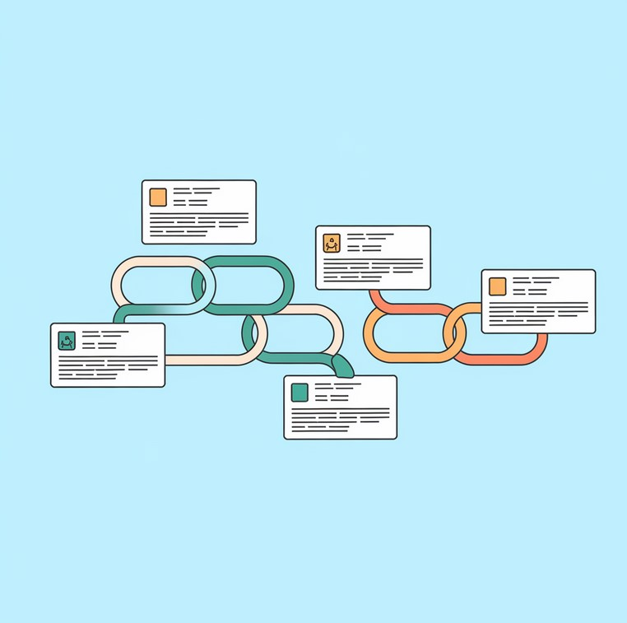
03
Medical Records
displayReports Function
displays all medical reports in a linked list.If the list is empty, it prints "No reports available." If the list has reports, it iterates through each node and prints details.This function provides a full display of all reports in the list, one by one.

Slide 13


Billing Records
04
L
I
N
K
E
D
L
I
S
T
This part of this system handle payment rec-ords by using patient ID’s.To dynamically mana- age billing records using linked lists, including
operations for adding, deleting, sorting, and displaying records by patient ID.

Slide 14
0202 Billing Records
04​
This sorting method efficiently organizes the billing records by patientID without needing additional data structures, making it well-suited for linked lists. The use of insertion sort allows for smooth insertion at various points in the list as it builds the sorted version.
S
O
R
T
I
N
G
Rearrange the records in the linked list based on the patientID in ascending order.
Insertion sort is chosen because it is efficient for linked lists, as it requires minimal additional memory and can be implemented in-place.
Insertion sort is chosen because it is efficient for linked lists, as it requires minimal additional memory and can be implemented in-place.

Slide 15

05
WAITING Room
Waiting Room Management is a crucial aspect of hospital operations that focuses on efficiently managing patients who are waiting for their appointments or treatments. A well-organized waiting room system ensures that patients are attended to in a timely manner, reduces overcrowding, and enhances the overall patient experience. By implementing a systematic approach to managing the waiting area, hospitals can improve patient flow, minimize wait times, and optimize resource allocation.

Slide 16
CHALLENGES IN WAITING ROOM
Challenge :-
Overcrowding: High patient volumes can lead to overcrowded waiting rooms, causing discomfort and anxiety among patients.
Inefficient Patient Flow: Without a structured system, patients may not be seen in the order they arrive, leading to frustration and dissatisfaction.
Communication Gaps: Patients may not be informed about delays or changes in their appointment status, resulting in confusion and a poor experience.
Resource Allocation: Difficulty in managing staff resources effectively can lead to longer wait times and reduced quality of care.
Data Management: Keeping track of patient information and status in a dynamic waiting room environment can be challenging without proper systems in place.
o

Slide 17
HOW HOSPITAL MANAGEMENT WORKS IN QUEUE
Data Structure Definition :
A structure named Waiting Room is defined to represent the queue. It contains:
.An array patients to hold the names of patients.
.Two integer variables, front and rear, to track the positions of the front and rear of the queue.
j
Initialization :
1. The function int_waiting_room initializes the waiting room by setting both front and rear to zero, indicating that the queue is empty.

Slide 18
HOW HOSPITAL MANAGEMENT WORKS IN QUEUE
Queue Operations: 1. Check if Full: The function is_full checks if the queue is full by determining if incrementing the rear index would wrap around to the front. 2.Check if Empty: The function is_empty checks if the queue is empty by comparing the front and rear indices. 3.Add Patient: The function add_patient adds a patient's name to the queue. If the queue is full, it prints an error message; otherwise, it copies the patient's name to the patients array and increments the rear index. 4.Remove Patient: The function remove_patient removes a patient from the front of the queue. If the queue is empty, it returns NULL. Otherwise, it copies the name of the patient being removed and increments the front index. 5.Print Waiting List: The function print_waiting_list iterates through the queue from front to rear, printing the names of all patients currently waiting.
n

Slide 19
HOW HOSPITAL MANAGEMENT WORKS IN QUEUE
Main Function
The main function serves as the entry point for the program. It initializes the waiting room and presents a menu to the user with four options:
Add Patient: Prompts the user to enter a patient's name and adds it to the queue.
Remove Patient: Removes the patient at the front of the queue and displays their name.
Print Waiting List: Displays the names of all patients currently in the waiting room.
Exit: Terminates the program.

Slide 20
HOW HOSPITAL MANAGEMENT WORKS IN PRACTICE
1.Adding Patients: When a patient arrives, the receptionist can add their name to the waiting list using the "Add Patient" option. This adds the patient's name to the end of the queue.
2.Removing Patients: When a patient is called for their appointment, the staff can remove them from the queue using the "Remove Patient"option. This ensures that patients are seen in the order they arrived. 3.Viewing the Waiting List: Hospital staff can use the "Print Waiting List" option to view all patients currently waiting. This helps in managing patient flow and keeping track of who is next.
4.Handling Overcrowding: The system checks for a full queue and prevents adding more patients if the waiting room is at capacity, helping to manage overcrowding effectively.

Slide 21
CONCLUSION
The implementation of a comprehensive hospital management system utilizing various data structures and algorithms significantly enhances the efficiency and effectiveness of healthcare delivery. By organizing patient records, appointment scheduling, emergency management, pharmacy operations, billing, staff scheduling, waiting room management, laboratory tests, and blood bank management, hospitals can streamline their processes and improve patient care.
A well-structured hospital management system is vital for modern healthcare facilities. By leveraging appropriate data structures and algorithms, hospitals can improve patient care, streamline operations, and ultimately contribute to better health outcomes in their communities.

Slide 22
Limitations
1.Features - There are few features in the project. Adding some more features like appointment scheduling, emergency ward, laboratory test records, blood bank etc.
2.To more simplify we can use to implement those features using arrays, hash tables , file based etc.

Slide 23
Limitations
3.As the patient database grows, the system may struggle with
performance and data management.
4.If the waiting room feature lacks real-time updates or effective tracking, it can lead to poor patient flow and long wait times.

Slide 24
Limitations
5.Inaccurate billing records due to manual errors or insufficient billing features can lead to disputes and delayed revenue cycles.

Slide 25
Future Scope
1.Expanding telemedicine capabilities to facilitate remote consultations and follow-ups, enhancing patient access and convenience.

Slide 26
QUESTION?

Slide 27

THANK YOU!

